Slide 1

Predicting Employee Productivity in the Garment Factory Using Machine Learning Techniques
FRANCESCO MANCO
MACHINE LEARNING COURSE

Slide 2
INTRODUCTION
This project aims to predict employee productivity in a clothing factory by classifying performance as "High Productivity" or "Low Productivity.“
The approach uses various classifiers and, through hyperparameter optimization techniques, compares these models with statistical tests to determine the most effective one.

Slide 3
DATASET
The dataset is sourced from the UCI Repository and contains 1197 samples representative of working days in a factory. The 15 features present in the dataset are as follows:
date: Date in MM-DD-YYYY format.
day: Day of the week.
quarter: A portion of the month. A month is divided into four quarters.
department: Department associated with the instance.
team_no: Number of the team associated with the instance.
no_of_workers: Number of workers in each team.
no_of_style_change: Number of style changes for a particular product.
targeted_productivity: Target productivity set by authority for each team daily.
smv: Standard Minute Value, time allocated for a task.
wip: Work in Progress, number of incomplete items in production.
over_time: Amount of overtime performed by each team, in minutes.
incentive: Amount of financial incentive (in BDT) that motivates a specific course of action.
idle_time: Time during which production was halted for various reasons.
idle_men: Number of inactive workers due to production halting.
actual_productivity: Actual percentage of productivity achieved by workers, ranging from 0 to 1.

Slide 4
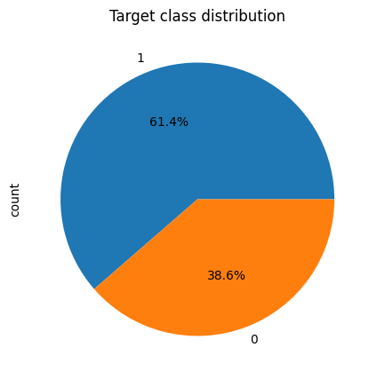
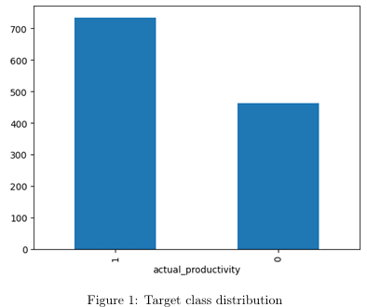
TRANSITION FROM REGRESSION TO CLASSIFICATION
The dataset is created for a regression task.
Transition from regression to classification by setting a threshold based on the target_productivity feature.
Result after the transition:
High Productivity (1): 735
Low Productivity (0): 462

Slide 5
PRE-PROCESSING STAGE
A subsequent pre-processing phase was undertaken using various techniques such as:
Merging the values "finishing_" and "finishing" into a single value in the department feature.
Combining the values "Quarter 4" and "Quarter 5" into a single value "Quarter 4" in the quarter feature.
Handling missing values for the "WIP" feature by imputing with its mean.
Removing the column "date".
Applying One-Hot Encoding to the features 'quarter', 'department', and 'day'.

Slide 6
CONDUCTING EXPERIMENTS
Train-test split: 80 - 20
Nested cross validation for hyper parameter tuning (based on «f1_weighted»)
Model selected:
KNN
Logistic Regression
Decision Tree
Random Forest
Final comparison of models using paired t-test

Slide 7
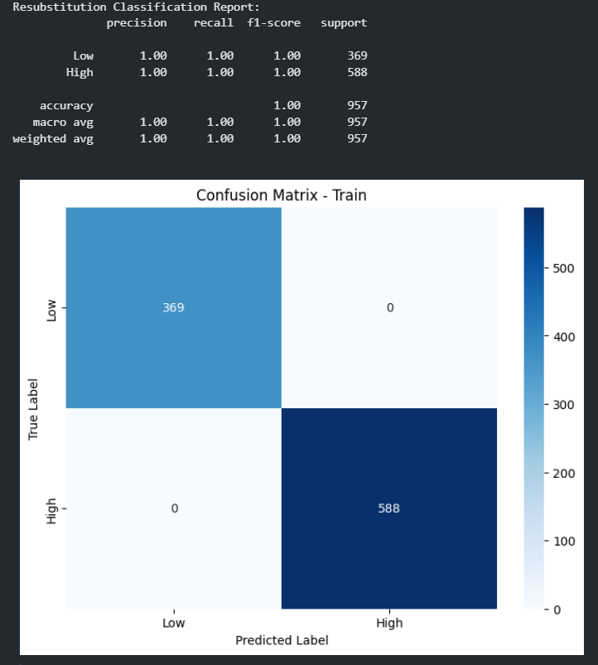
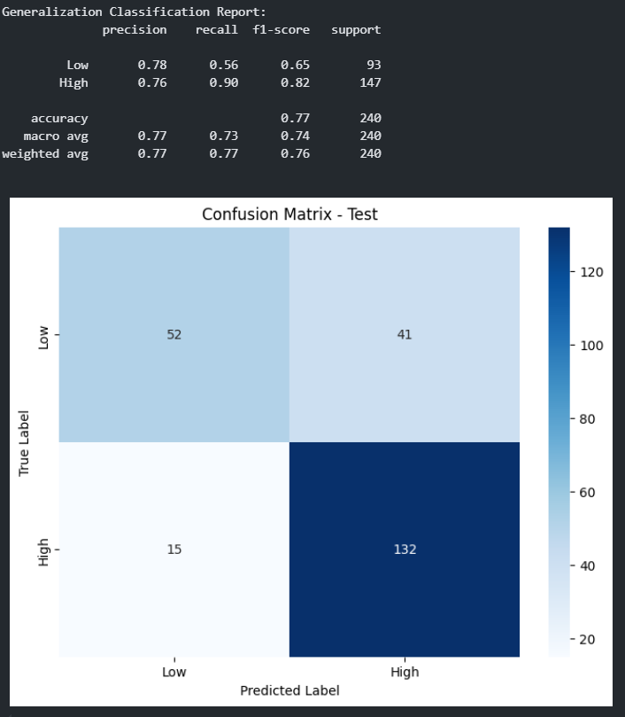
KNN EXPERIMENT
Mean accuracy of nested cross-validation: 0.78
Mean precision of nested cross-validation: 0.78
Mean recall of nested cross-validation: 0.78
Mean F1-score of nested cross-validation: 0.78

Slide 8
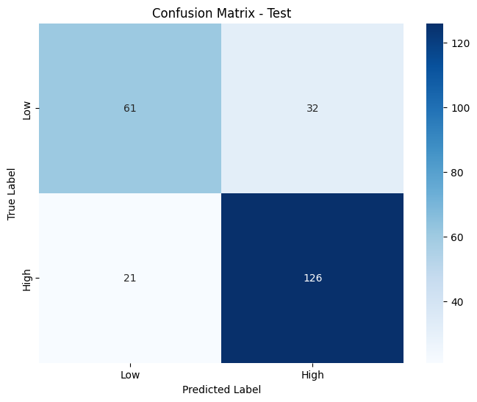
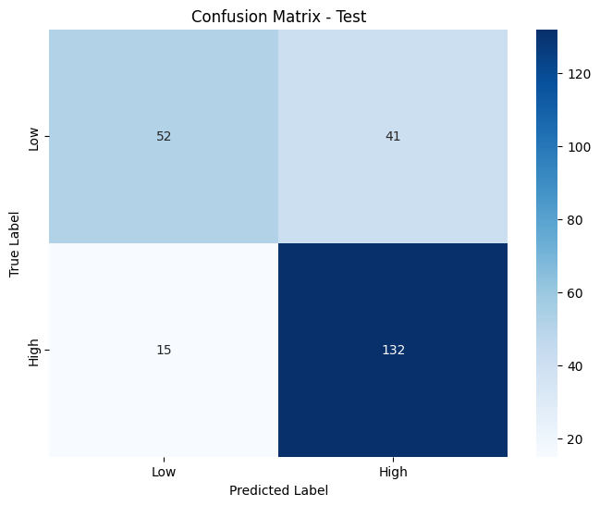
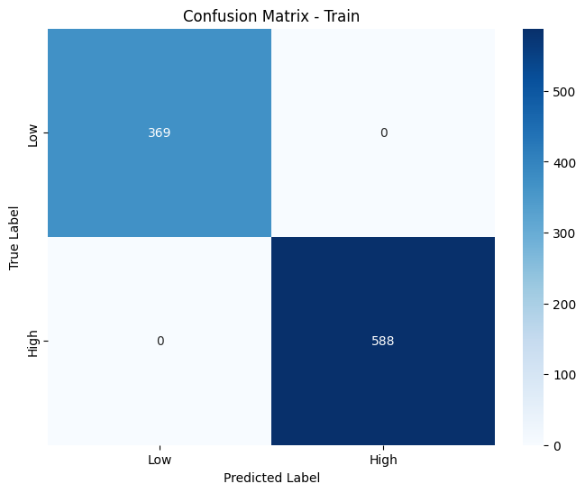
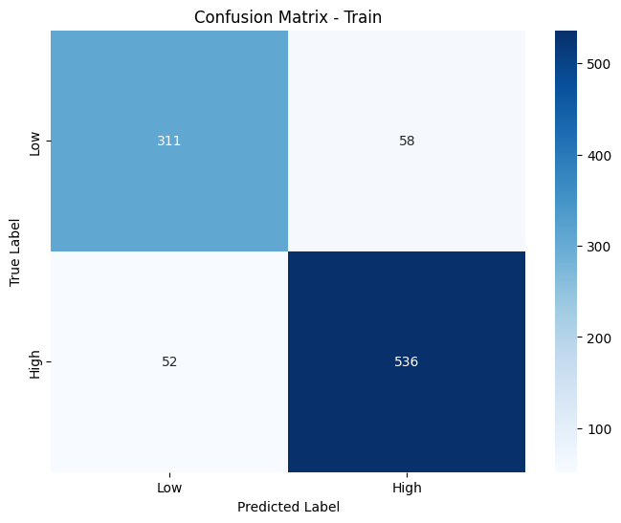
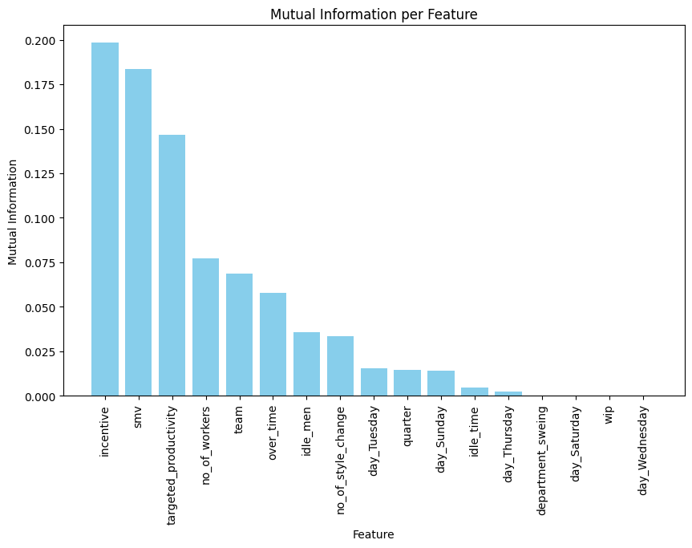
Overfitting in KNN
Test set
Considering the overfitting issues found in the model, feature selection was performed using mutual information, identifying the three most significant features: incentive, smv, target productivity.
With fewer features, the KNN model is forced to focus on only the three most informative features for classification. This allows it to generalize better on the test data.
Training set

Slide 9
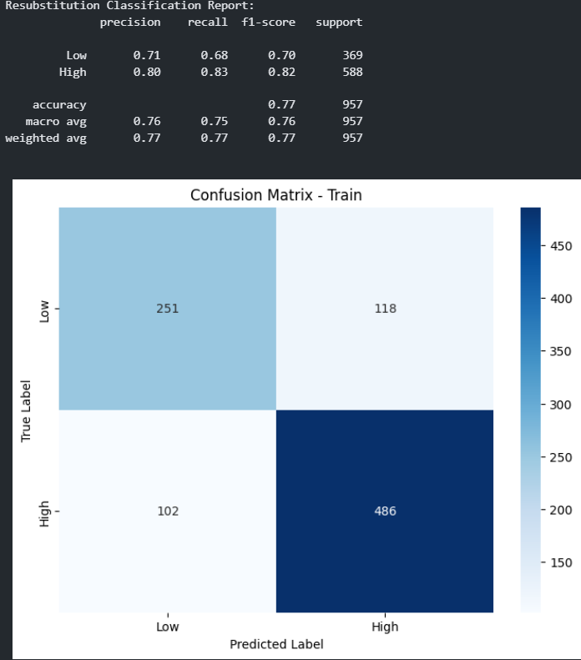
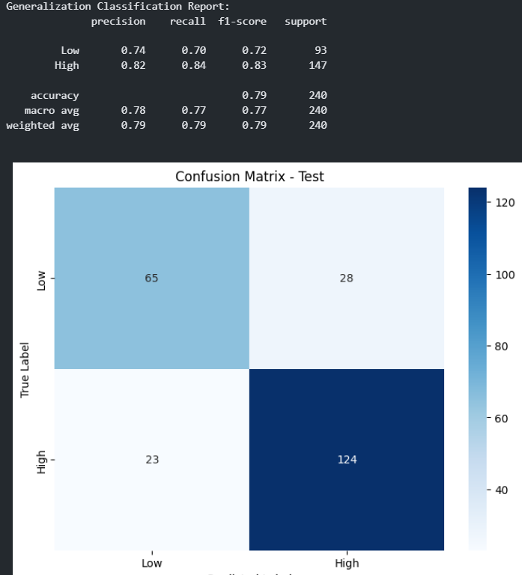
LOGISTIC REGRESSION EXPERIMENT
Mean accuracy of nested cross-validation: 0,77
Mean precision of nested cross-validation: 0.77
Mean recall of nested cross-validation: 0.77
Mean F1-score of nested cross-validation: 0.77

Slide 10
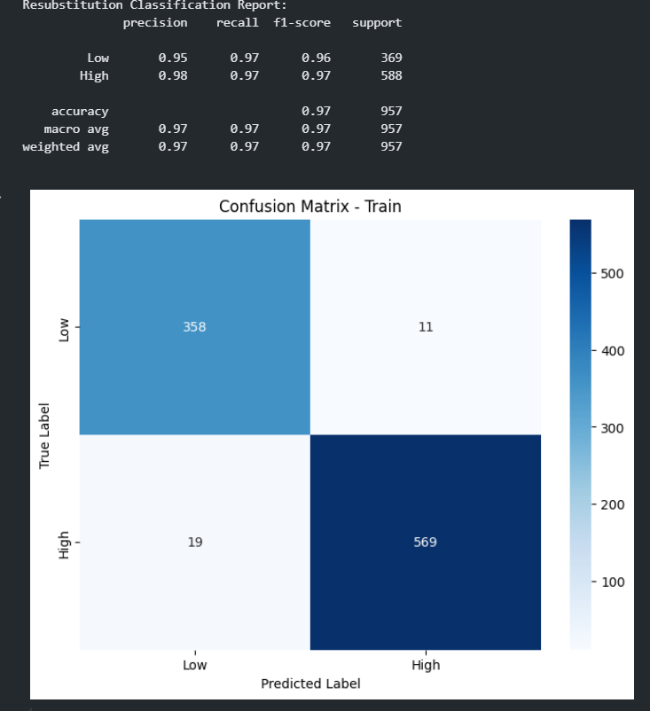
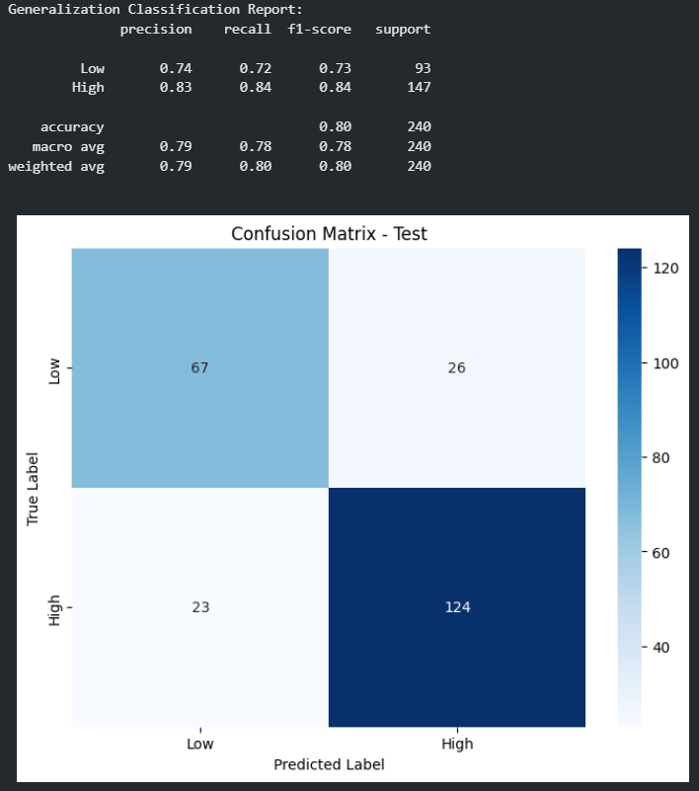
DECISION TREE EXPERIMENT
Mean accuracy of nested cross-validation: 0,82
Mean precision of nested cross-validation: 0.83
Mean recall of nested cross-validation: 0.82
Mean F1-score of nested cross-validation: 0.82

Slide 11
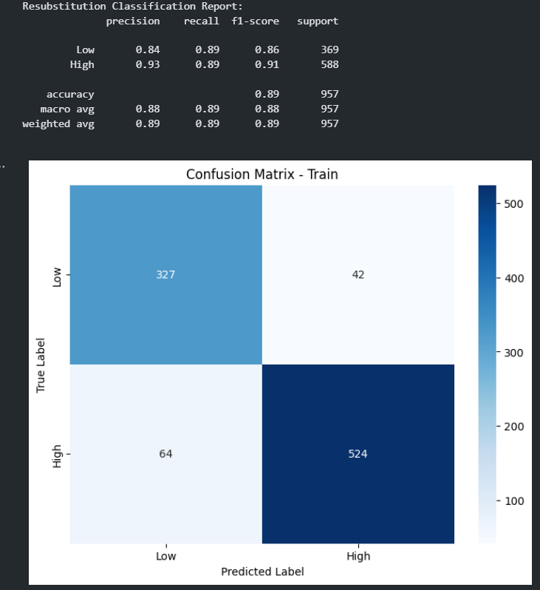
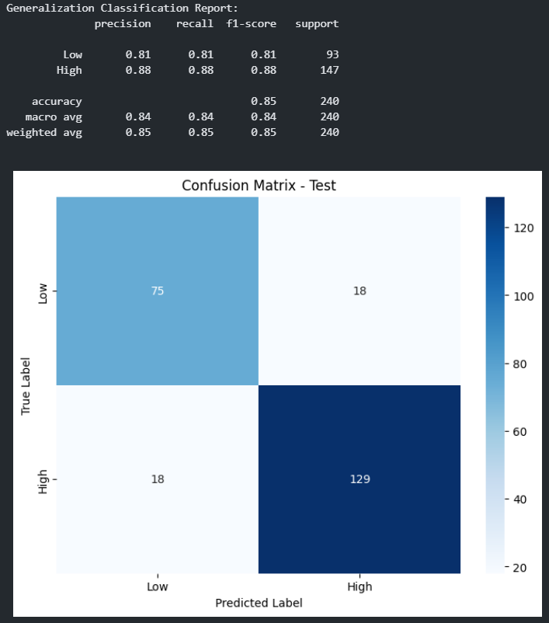
RANDOM FOREST EXPERIMENT
Mean accuracy of nested cross-validation: 0.85
Mean precision of nested cross-validation: 0.85
Mean recall of nested cross-validation: 0.85
Mean F1-score of nested cross-validation: 0.85

Slide 12
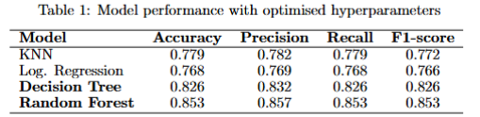
HYPERPARAMETER TUNING RESULTS

Slide 13
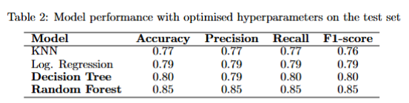
MODEL TESTS

Slide 14
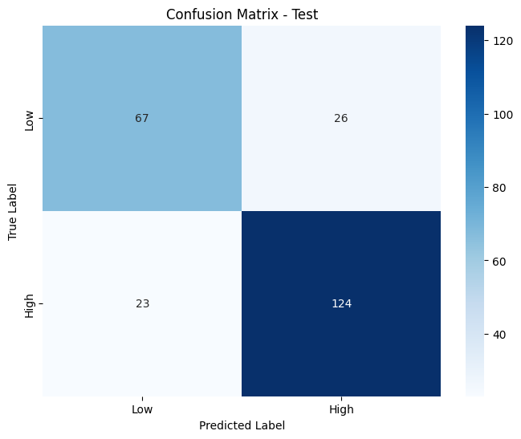
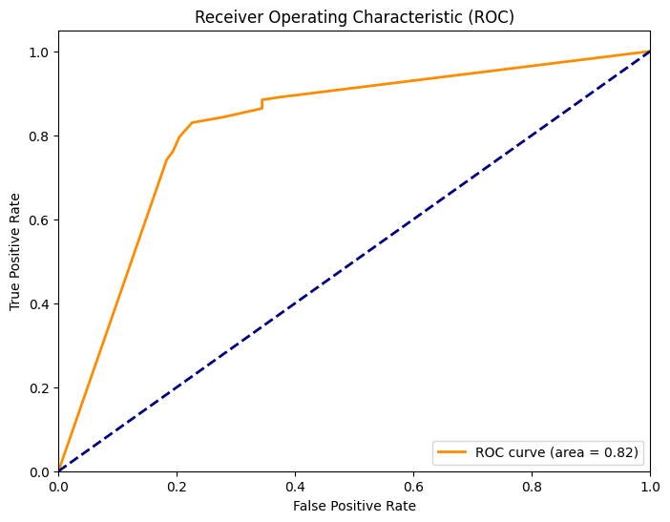
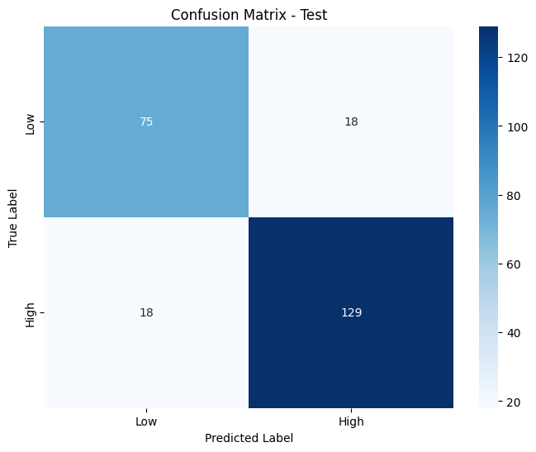
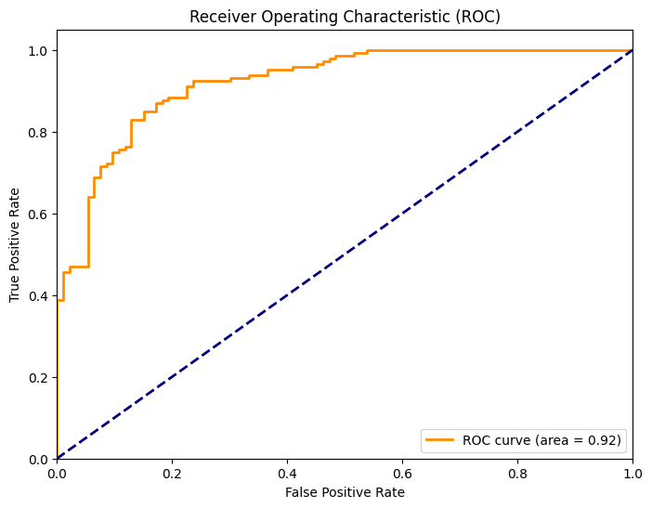
MODEL COMPARISON
DECISION TREE
For the comparison of models, ROC (Receiver Operating Characteristic) curves were analyzed and a paired t-test one-vs-one was applied. The Random Forest model achieved the best AUC (0.92), and all comparisons revealed statistically significant differences (p-value < 0.05), confirming Random Forest as the superior model for this task.
RANDOM FOREST

Slide 15
CONCLUSION
This study successfully implemented a classification system for the prediction of employee productivity in the industrial context of the garment industry.
The rigorous methodological approach and the systematic optimization of the models led to the identification of the Random Forest as the optimal algorithm, with significantly higher performance (accuracy: 85%, AUC: 0.92).
These results provide a robust framework for the implementation of productivity prediction systems in similar industrial settings.

